Slide 1
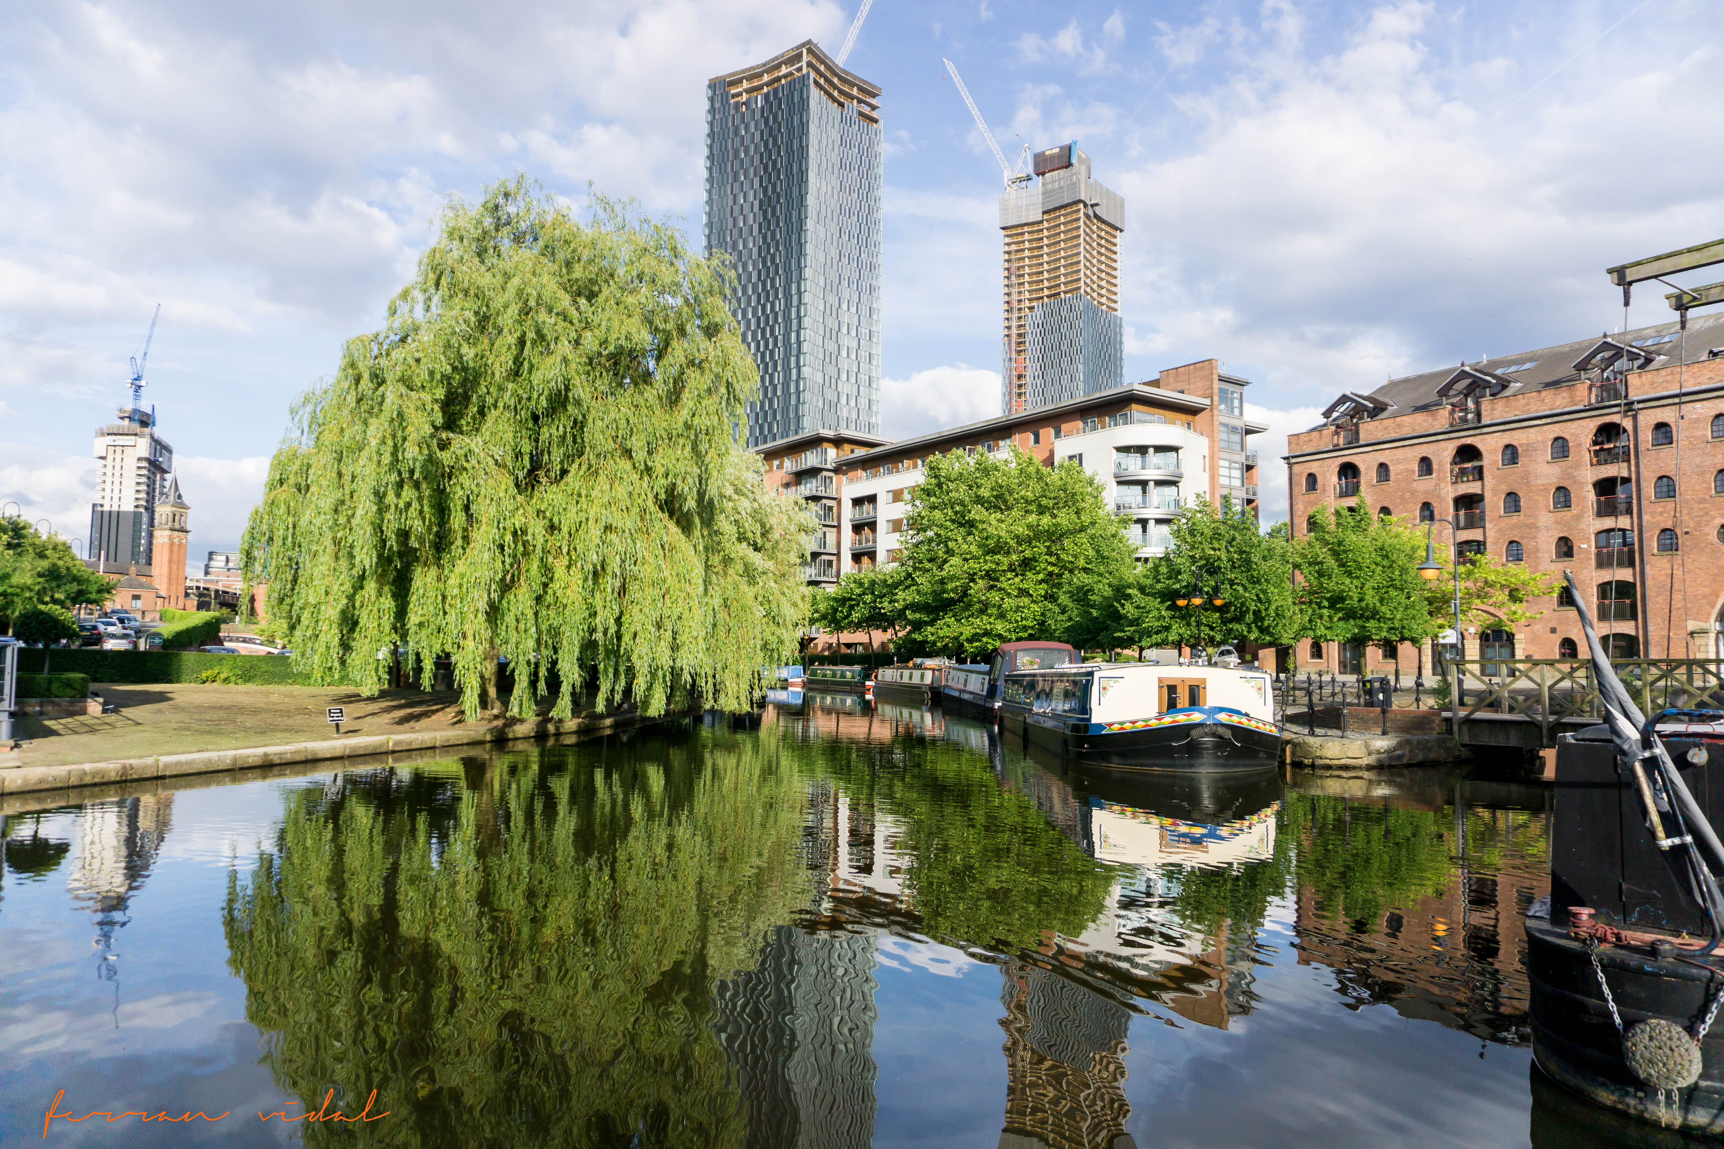

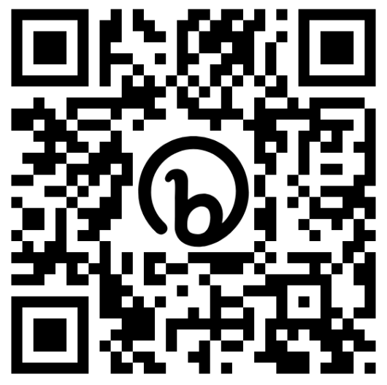



Greater Manchester Integrated Water Management Plan
24 April 2024

Slide 2
Headlines
Greater Manchester is connected by water but how we manage it is highly fragmented.
Issues are brought to light on frequent occasions when there is too much water (flooding), too little (droughts) and too dirty (polluted waterways).
Programmes, projects, policies, standards and communications are planned and delivered in isolation – with fragmented delivery across silos and within organisations.
We cannot create the ideal world where multiple investment programme cycles are always in sync.
We need more blue/green infrastructure in urban spaces.
Interventions required at different catchment scales and to manage water differently.
There is also a resource capacity and capability challenge, with limited continuity planning (especially within the Combined Authority (CA)/Local Authorities and within the Environment Agency (EA))
A whole system change is required.

Slide 3

demand
Outcomes
water quantity
water quality
Water Companies
Environment Agency
low carbon
growth and regeneration
Transport
Local Authorities
Developers
improve
connectivity
Highways
economic development
Consumers

Slide 4
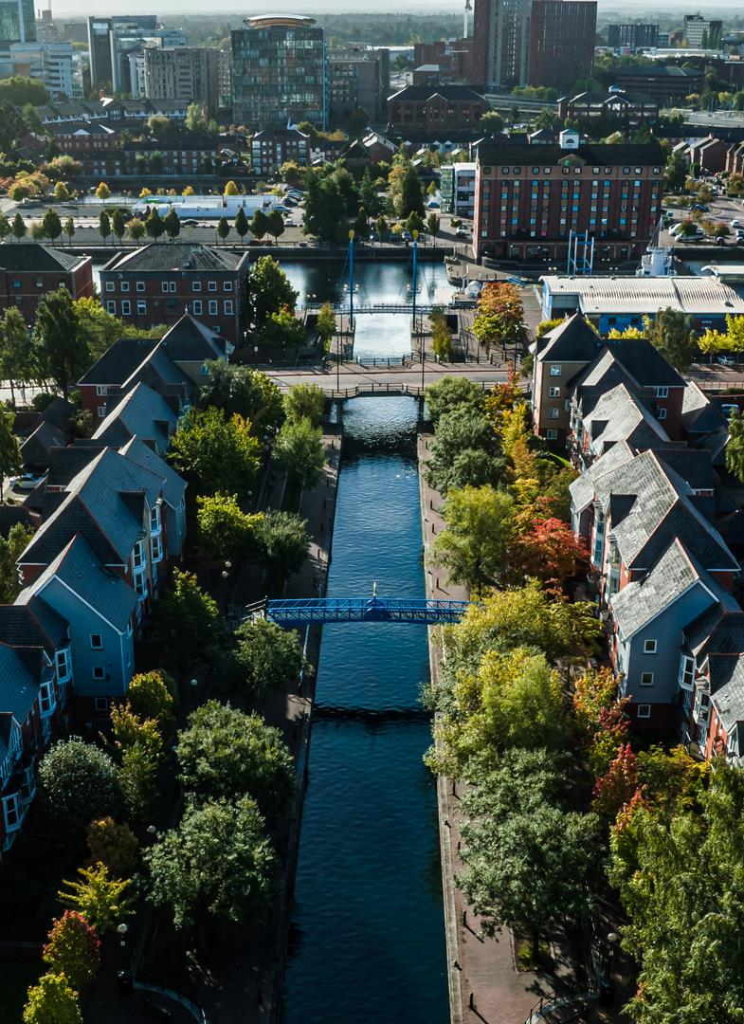
Vision
We will collaborate to break barriers to manage water in an integrated way to enable the delivery of sustainable growth in Greater Manchester.
We will ensure that all interventions consider water neutrality, flood resilience, water quality improvement and build in climate adaptation.
We will involve businesses and community stakeholders to deliver resilient, diverse and inclusive public spaces.
Working together, we will manage Greater Manchester's water wherever it falls, to enhance the environment, support people and forge prosperous places.​
Notes:
And with our journey in mind, we have a clear vision for what we are to achieve, live and work by.
To enable the vision we have 3 core outcomes of:
Breaking down the barriers
Creating multiple benefits
Businesses and the community become an important part in creating the value.

Slide 5
Vision, ambitions, objectives and workstreams
Notes:
The thinking behind our plan to achieve integrated water management aligns with many of the UN SDGs.
Whilst it aligns with 6……8…..11 and 15, it will also support the improvement in health and well being (3) and (14) life below water and full implementation of the plan and realisation of its outputs, including the skills and training academy, could also support quality education (4), industry, innovation and infrastructure (9), responsible consumption and production (12), climate action (13) and partnerships (17)

Slide 6
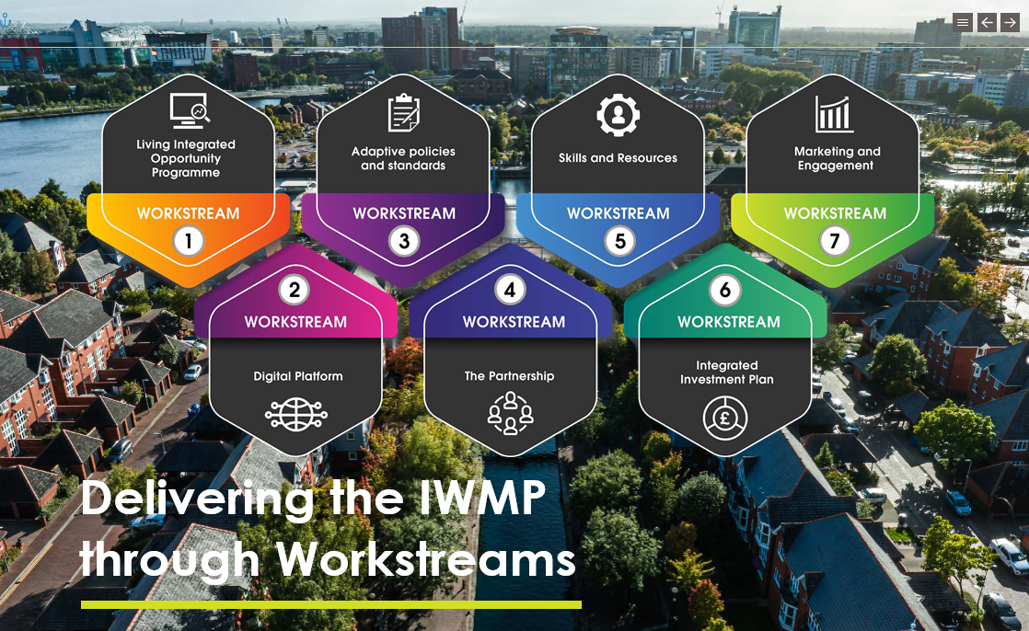
Seven Interdependent workstreams

Slide 7
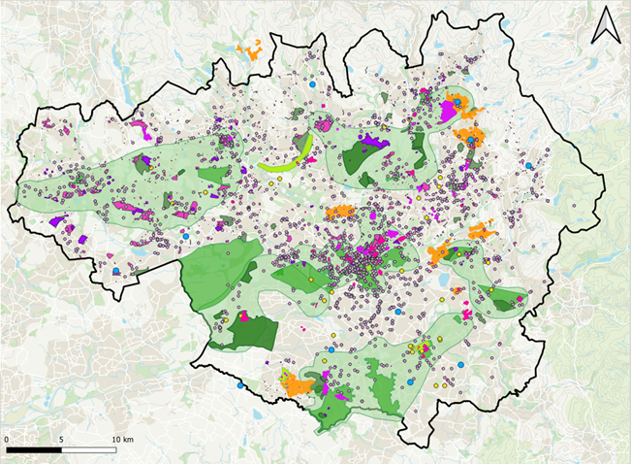
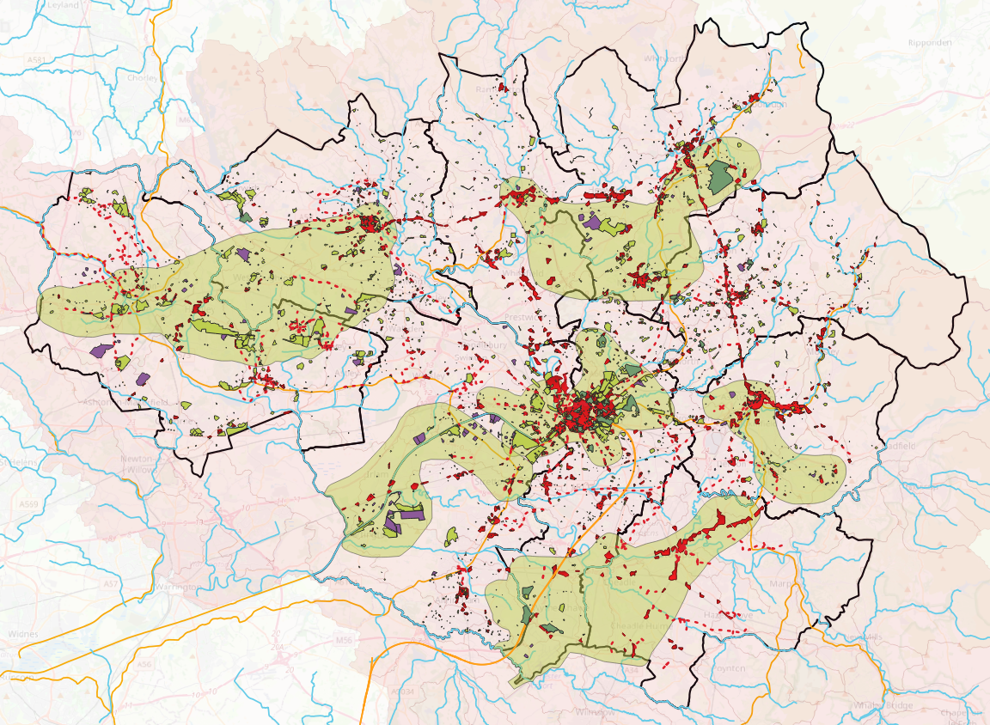
WS 1 - Living Integrated Opportunity Programme
The programme will join opportunities up that align spatially, driving investments and solutions that deliver better value compared to traditional solutions, leveraging funding from other sources where there is an alignment in objectives and by challenging delivery to be more efficient – 500+ clusters
60 datasets
20 programmes
400 clusters
9,250 interventions
+32,000 data entries
Notes:
An initial high-level assessment aligned several programmes of water-related opportunities from the Environment Agency and United Utilities with transport and regeneration opportunities from GMCA. This identified more than 100 locations with potential for multiple water investment opportunities to be integrated along with more than 300 locations where there was non-water investment at flood risk that could also become the focus of the programme.
Further refinement has created a list of 347 locations in which there is the potential for integrated opportunities to be delivered. Of these, 174 lie within growth areas and 125 (see pink clusters in image below) also within watersheds in which catchment-based solutions could provide most benefit. The clusters form the basis of potential integrated opportunities that can be further prioritised.

Slide 8
Simplified Living Integrated Opportunity Programme Process
Digital Platform
Living Integrated Opportunity Programme
Ad Hoc
Parked Opportunities
Gateway
Opportunity Collation
Opportunity Analysis
Initial Review Meeting
Integrated Opportunity Review
Programmes
More information required
Marketing and Engagement
Integrated Investment Plan

Slide 9
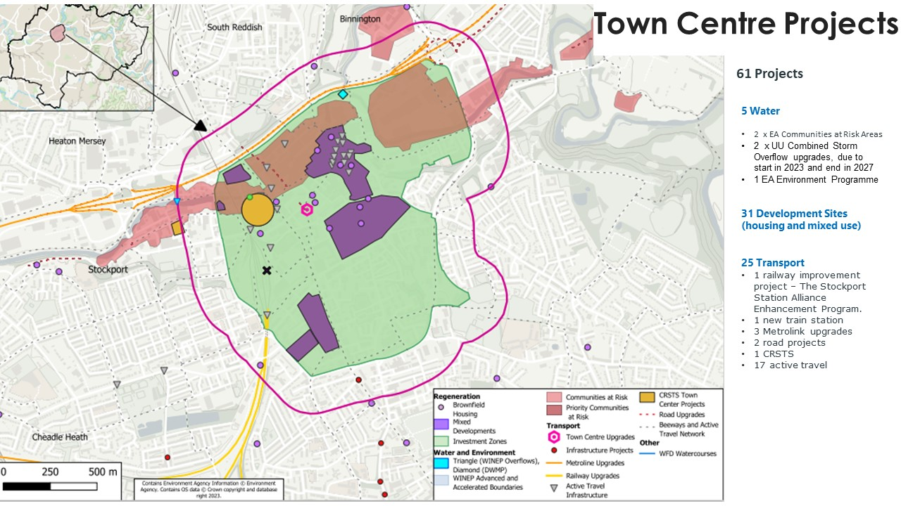
Stockport town centre projects
Stockport EV bus station – UU programme acceleration
Stoc8 regeneration area

Slide 10
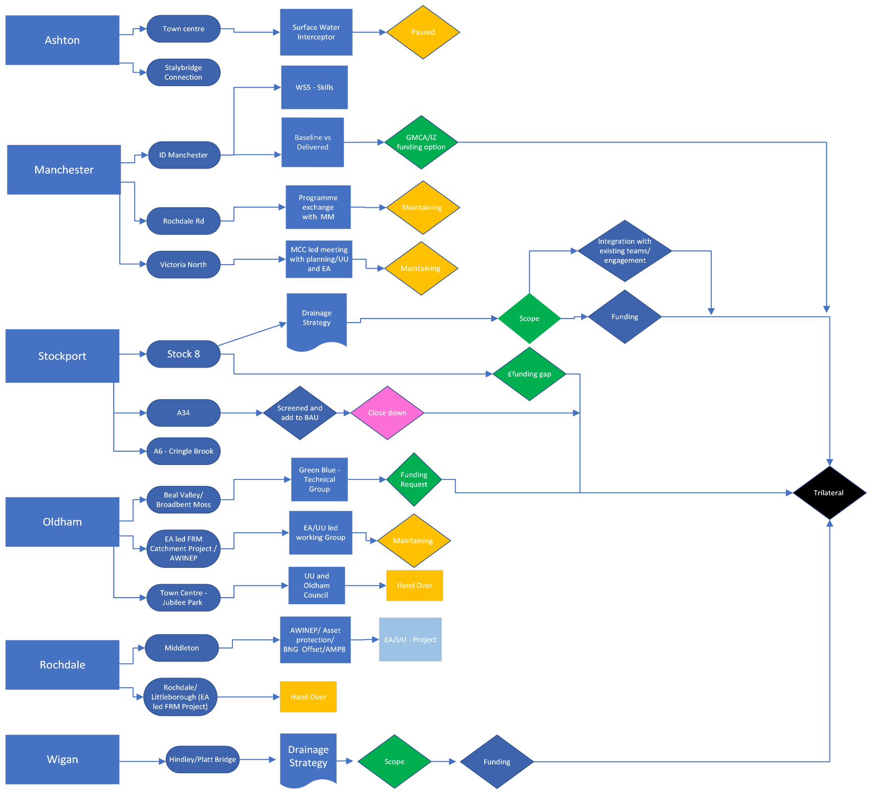
Stuff happening and meetings
Decision makers
Real world places

Slide 11
Drainage Strategy Questions
What's the infrastructure requirement?
An intervention using billpayers/other public funding required to bridge the gap between BAU and an optimum solution that delivers wider/longer term benefits – note to confirm is this about mitigating the impact of X new homes or Y new commercial space of should development be leveraged to deliver an agreed water/environment/infrastructure benefit or both?
Next Steps:
Who will benefit (and therefore the investment case)
What are the strategic drivers (for UU identify the catchment driver for SOs) – GMCA/EA and Stockport
Agree the catchment scale the town centre resides
Identify if any modelling is required
Explore the underground vs overground - and best fit mix.
CA and UU funding criteria
What is necessary and what is desirable – BAU is any improvement above existing it’s not an improvement against a quantified flow into a combined sewer and identification of a strategic solution benefitting more than one development.
Confirm the cost assumptions and whether they are reasonable eg construction and design costs?
Current stage in development Cycle (for the LA/GMCA/UU and EA)
Anticipated delivery year(s) – 2024-2030
Anticipated public cost & funding gap
Working group – across UU/EA/CA and LA etc.

Slide 12
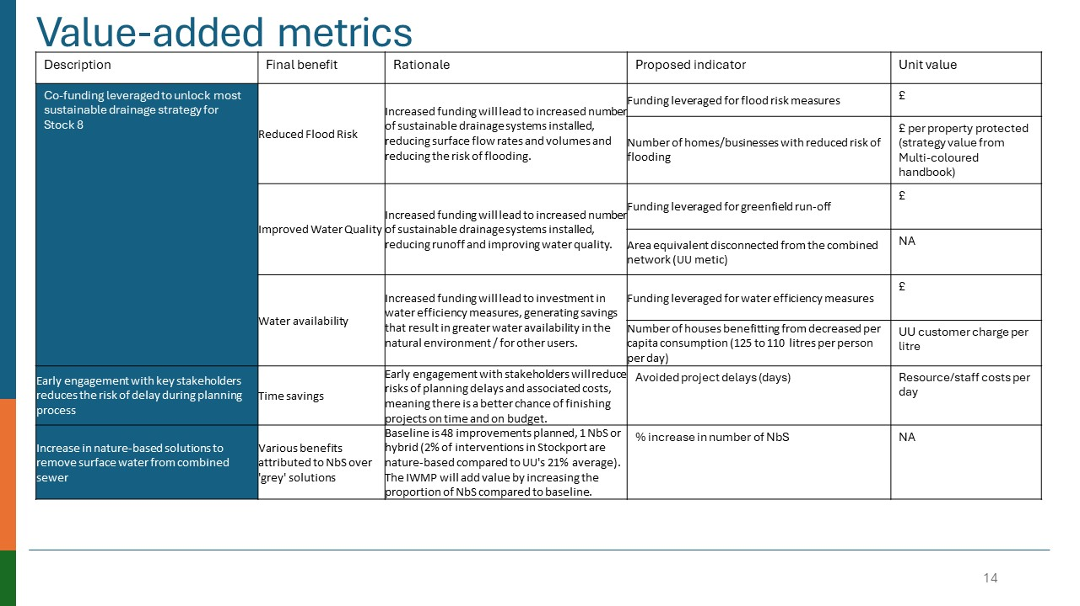
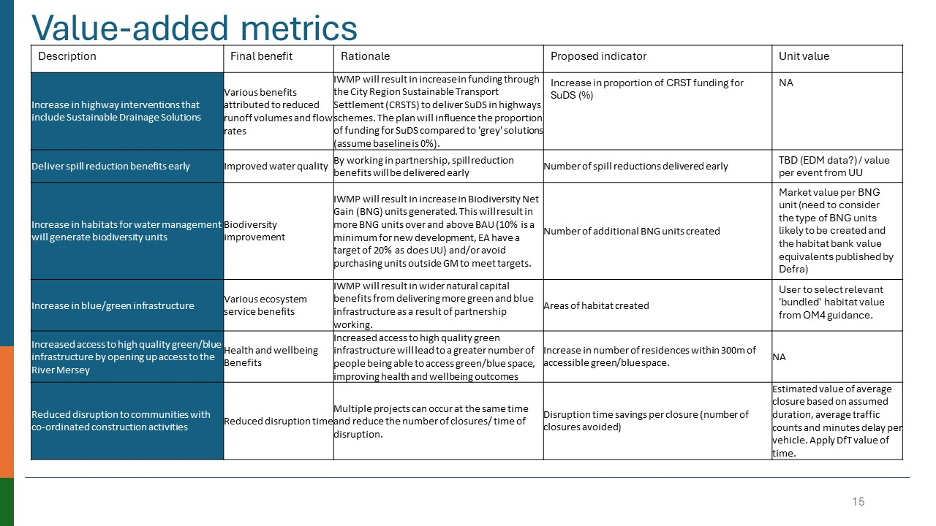
Evaluation

Slide 13
Lessons Learnt
A vision…and a clear purpose for the team.
Initiate systems thinking earlier and identify opportunities.
Collaboration based on trust is the key to meeting these challenges head-on to find the right solutions.
Trust “trust” cultivates an environment and “culture” of innovation.
Clear goals, accountability and collective reporting are required.
Creating the team charter brought together value from across different organisations.
Building skills in collaboration also eliminates silos and group think and streamlines processes, leading to increased efficiency and cost savings.
Organisations can avoid duplicating efforts (and create peak collisions) and optimise their operations, ultimately benefiting sector professionals and the environment.

Slide 14
Evolution of the partnership through actions to enable change
2029
By the end of 2023
2026
NOW
IWMP
EMBED CULTURE AND VALUES
EVOLVE CORPORATE GOVERNANCE
ESTABLISH FORMAL PARTNERSHIP GOVERNANCE ESTABLISHED
DEVELOP DELIVERY VEHICLE UNDERSTANDING
STEERING GROUP
CREATE ACCESSIBLE DIGITAL TOOLS,
INTEGRATION THROUGH DIGITAL TOOLS
Between Funded Water and Multi sector partnership
LIMITED AD-HOC OPPORTUNITIES
INCREASE WIDER ENGAGEMENT
CONTRACTUAL & WAYS OF WORKING APPROACH DEFINED ACROSS MULTI SECTOR
PREPARE FOR DELIVERY INTEGRATION
DATA SHARED WHEN REQUESTED
CO-CREATED, CO-FUNDED, CO-DELIVERED OUTCOMES
DEPLOY INDEPENDENT CO-ORDINATOR ROLE/S AND SUPPORT TEAM
INTEGRATE PLANNING AND CO-CREATE PROGRAMMES AND DEVELOPMENT
INTEGRATE WIDER OPPORTUNITIES AND INVESTMENT PROGRAMMES
INCLUSION OF OTHER PROGRAMMES OF WORK OUTSIDE THE SECTOR
LIMITED VISIBILITY OF INVESTMENT PROGRAMMES
INCLUSION OF WIDER DATA USED
Between Collaborative Agreement and Systems Integrator
OUTCOME-ORIENTED BENEFITS TO WATER POLICY, INTERVENTIONS, CO-DESIGN AND CO-DELIVER
TEST & USE INTEGRATING OPPORTUNITIES FRAMEWORK
TRILATERAL DIRECTOR REPRESENTATIVES
FOCUSED FUNDING FOR TARGETED SMALL INITIATIVES
CREATE CO-FUNDED ROLES
GAIN WIDER STAKEHOLDERS CONTRIBUTIONS
HIGHLIGHT INTERACTIONS BETWEEN POLICIES & POTENTIAL ACTIONS
ALIGN OPPORTUNITIES
EMBED VISION & FRAMEWORK WITH WIDER SOCIAL/ENVIRONMENTAL OUTCOMES
AGREE & FINALISE OBJECTIVES AND METRIC
DISCREET OPPORTUNITIES
MoU
INDIVIDUAL BESPOKE FUNDING OF PROJECT
OPPORTUNITIES INFORMAL REPORTING
POLICIES REVIEWED, GAPS IDENTIFIED
LOOSE AGREEMENT TO COLLABORATE
LIMITED ENGAGEMENT

Slide 15
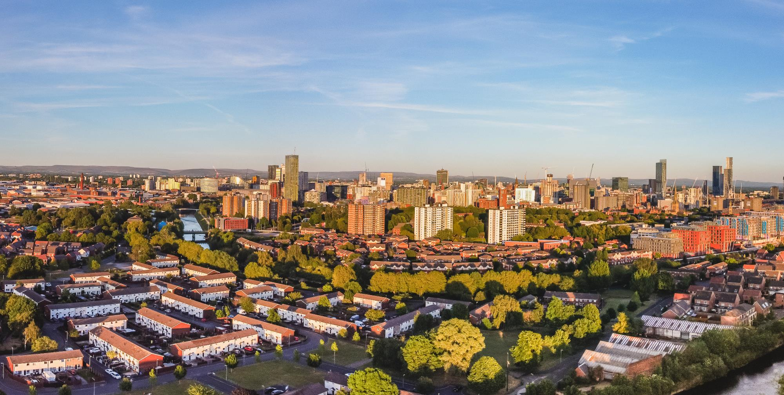

Thank you
To find out more information on the Greater Manchester Integrated Water Management Plan, scan the QR code

